Slide 1
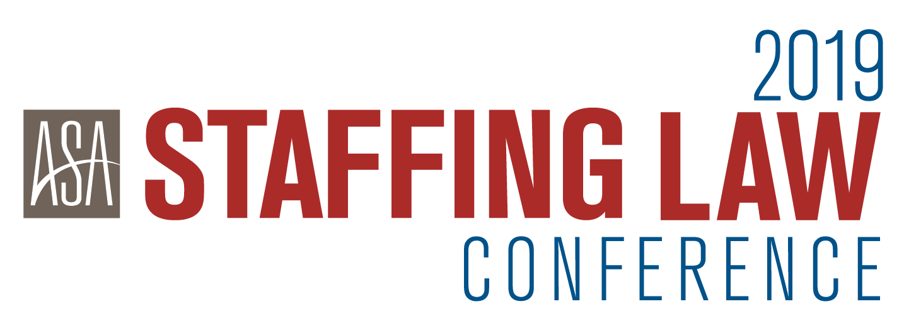

Slide 3
Give and Toke: A Conversation About Marijuana and the Workplace

Slide 4
Presenters
Eric J. Janson., Esq., Partner, Seyfarth Shaw LLP
Jenifer L. Kienle, Esq., Partner, Lewis Brisbois Bisgaard & Smith LLP
Robert Thompson, Vice President, World Wide Specialty Programs

Slide 5
Today’s Agenda
1 | Overview of state and federal laws regarding medical and recreational marijuana use
2 | Conflicts between state and federal law regarding marijuana and the workplace and developing caselaw.
3 | Marijuana Use from an Insurance Perspective [REVISE TITLE]
4 | OSHA / Safety Considerations [REVISE TITLE]

Slide 6
Introduction
A growing number of states are legalizing medical marijuana and prohibiting discrimination against employees who use marijuana for disabilities/medical conditions
Marijuana remains illegal under federal law
Litigation is growing, with trend supporting employees who use marijuana for medical reasons
Until SCOTUS rules or federal law changes (both of which seem unlikely soon), employers are in a precarious space with no clear guidance.

Slide 7
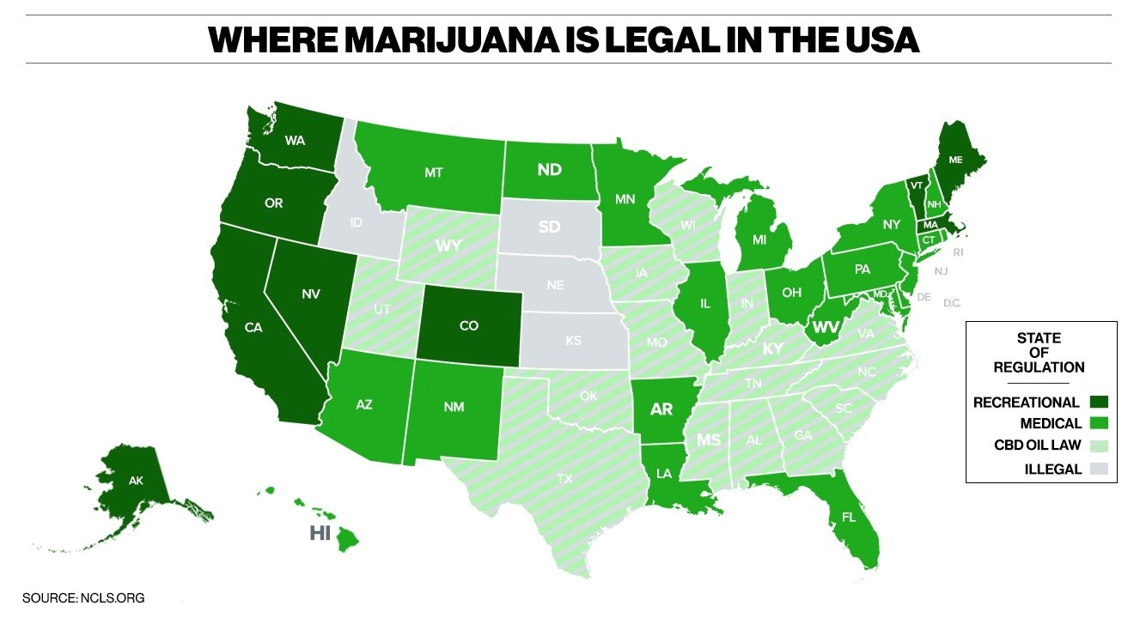

Slide 8
Federal Laws Governing Marijuana
Controlled Substances Act (“CSA”) (21 U.S.C. 801 et. seq.)
Marijuana is classified as Schedule I substance under the CSA and thus illegal to possess or use under federal law.
High Potential for Abuse
No Currently Accepted Medical Use for Treatment
Treated Same as Heroin, LSD, Ecstasy
BUT……
2016 DEA denied attempt to re-schedule but agreed to increase access for research.
June 2018 – FDA approved 1st drug derived from marijuana (Epidiloex) for 2 types of severe childhood epilepsy (.01% THC)
August 2018 – DEA announced drugs, including CBD with THC content below .01% are not considered Schedule 5 drugs as long as FDA approved.
December 2018 – Agriculture Improvement Act of 2018 (“2018 Farm Bill”) – removed hemp from CSA and amended definition of hemp to include “all derivatives, extract, cannabinoids”

Slide 9
Marijuana and Federal Employment Laws
Americans with Disabilities Act (ADA)
“[a] qualified individual with a disability shall not include any employee or applicant who is currently engaging in the illegal use of drugs when covered entity acts on the basis of such use.” 42 U.S.C. § 12114
“Illegal drug” = “the use of drugs, possession, or distribution of which is unlawful under the Controlled Substances Act…” 42 U.S.C. § 12111(6)(A)
ADA does not require employers to accommodate use of marijuana, even if lawfully prescribed
Accommodation obligation may exist for underlying medical condition, regardless of use of marijuana for treatment.

Slide 10
Marijuana and Federal Employment Laws
Family Medical Leave Act (FMLA)
Up to 12 weeks of unpaid leave for their own serious health condition or to care for a qualifying family member.
FMLA permits employees to take leave on an intermittent basis or to work a reduced schedule under certain circumstances
What about employees who use marijuana during FMLA time as treatment for medical condition?

Slide 11
Some States Have Passed Medical Marijuana Laws Expressly Prohibiting Employment Discrimination
Arkansas
Arizona
Connecticut
Delaware
Illinois
Maine
Minnesota
Nevada
New York
Oklahoma
Pennsylvania
Rhode Island
West Virginia

Slide 12
State Employment Protections for Medical MJ
Explicit Anti-Discrimination Statutes With Varying Protections (13 states)
(AZ, AR, CT, DE, IL, ME, MN, NV, NY, OK, PA, RI, WV)
Many state an employer is prohibited from taking adverse action based on status of being card-carrying medical MJ user;
However, 4 states (AZ, DE, MN, OK) have specific language prohibiting discrimination based on positive drug test for MJ;
See also: Maine (2018) -- protecting employees and applicants from adverse employment action based on off-duty marijuana use – including recreational use; employers can no longer test applicants for MJ)
Possible Protection from Adverse Employment Action (13 states + DC)
(AK, HI, LA, MD, MA, MI, MO, NH, NJ, NM, ND, UT, VT, DC)
Some protection under state disability discrimination law (state supreme court - MA);
Employee-friendly court decisions interpreting state law (MI, NJ, NM, DC);
Proposed legislation to provide anti-discrimination language (HI, MD, NJ, NY);
No Employment Protections (7 states)
(CA, CO, FL, MT, OH, OR, WA)
No Protection from Adverse Employment Action Based on Off-Duty MJ use (express statutory language; FL and OH)
No Duty to Accommodate Off-Duty Use (state supreme court decisions in CA, CO, MT, OR, WA)

Slide 13
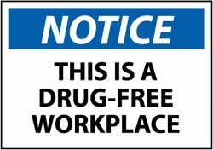
Pro Employer Decisions: Early Trend
Largely from states with marijuana laws that do not ban discrimination
Federal preemption
State laws only decriminalize use and do not require employers to tolerate it
Certain medical marijuana laws lack a private right of action
Discrimination on the basis of marijuana use is not disability discrimination under ADA
Accommodating marijuana use is not “reasonable” or imposes “undue hardship”

Slide 14
Pro Employer Decisions: Early Trend
Ross v. Ragingwire Telecommunications, Inc., 174 P.3d 200 (Cal. 2008): CA FEHA does not require accommodation of medical marijuana; CA medical marijuana law says nothing about employment and only decriminalizes use under state law.
Johnson v. Columbia Falls Aluminum Co. LLC, 213 P.3d 789 (Mont. 2009): employers have no duty under federal or MT disability discrimination law to accommodate medical marijuana use that would otherwise be legal under state law.
Emerald Steele Fabricators, Inc. v. Bureau of Labor & Industries, 230 P.3d 518 (Or. 2010): OR medical marijuana statute is conflict preempted by CSA.
Roe v. Teletech Customer Care Mgmt., 257 P. 3d 586 (Wash. 2011): not reasonable accommodation for employer to violate--or to allow employee to violate--federal law; medical marijuana statute does not provide a private right of action.
Casias v. Wal-Mart Stores, Inc., 695 F.3d 428 (6th Cir. 2012): MI medical marijuana law does not restrict employer’s right to discipline for use because law says nothing about employment and only decriminalizes use under state law.
Curry v. MillerCoors, Inc., No. 12-cv-02471-JLK, 2013 WL 2292307 (D. Colo. Aug. 21, 2013): “though [complainant] may never have used medical marijuana absent his disability, [respondent] did not unlawfully terminate him ‘because of' his disability’”.
Coats v. Dish Network, 350 P.3d 849 (Colo. 2015): CO off-duty lawful conduct statute does not protect medical marijuana use because it remains illegal under federal law.
Swaw v. Safeway, Inc., No. C15-939MJP, 2015 WL 7431106 (W.D. Wash. 2015): WA law does not require employer to accommodate medical marijuana use if it has a drug-free workplace, even if used off-site.
Steele v. Stallion Rockies Ltd., 14-cv-02376-CMA-BNB, 2015 WL 3396417 (D. Colo. May 26, 2015): dismissing discrimination claim of terminated employee because “antidiscrimination law does not extend so far as to shield a disabled employee from the implementation for his employer’s standard policies against misconduct”
Garcia v. Tractor Supply Co., 154 F. Supp. 3d 1225 (D. N.M. 2016): NM medical marijuana law combined with state anti-discrimination statute does not give employee a cause of action; NM medical marijuana law says nothing about employment and only decriminalizes use under state law, such that an employer is not required to accommodate use.
Shepherd v. Kohl’s Dep’t Stores, Inc., No. 1:14-cv-0190-DAD-BAM, 2016 WL 4126705 (E.D. Cal. Aug. 2, 2016): employer has no duty to engage in interactive process if the only demand for accommodation is medical marijuana use in violation of employer policy; granting summary judgment against California disability discrimination claim because there is no evidence “that plaintiff was fired because of his anxiety and not because of the manner in which he chose to treat that condition” via medical marijuana.
Carlson v. Charter Comms., No. CV 16-86, 2017 WL 3473316 (D. Mont. 2017): MT medical marijuana statute is preempted by CSA.
Cotto v. Ardagh Glass Packing, No. 18-1037, 2018 WL 3814278 (D. N.J. Aug. 10, 2018): NJ medical marijuana law is silent as to employment; does not require employer to accommodate use (relies on illegality under federal law)

Slide 15
Pro Employee Decisions: Recent Trend
Particularly addressing marijuana laws with express statutory employment protections
Marijuana just like any lawful prescription
Employees who use may be qualified disabled individuals, and impossible to separate disability from treatment
Interactive-process required
Undue hardship defense still available
Private right of action implied

Slide 16
Pro Employee Decisions: Recent Trend
Barbuto v. Advantage Sales & Marketing, 78 N.E.3d 37 (Ma. 2017): denying motion to dismiss and holding that employer could be liable under the Massachusetts anti-discrimination statute for disability discrimination by declining employment based on an individual’s off-duty medical marijuana use; tolerating off-duty medical marijuana use may be a “reasonable accommodation” of a disability under the Massachusetts anti-discrimination statute.
Callaghan v. Darlington Fabrics Corp., PC-2014-5680 (R.I. Super. Ct. May 23, 2017): RI medical marijuana act created implied private right of action under RI Civil Rights Act and employer violated RI’s medical MJ statute and RICRA when it refused to hire the plaintiff even though she admittedly could not pass the pre-employment drug test; granted summary judgment to plaintiff-applicant.
Noffsinger v. SSC Niantic Operating Co., No. 3:16-cv-01938, 2018 U.S. Dist. LEXIS 150453 (D. Conn. Sept. 5, 2018) granting summary judgment to job applicant on her claim that the federal contractor violated anti-discrimination provisions of CT’s medical marijuana law when it rescinded her job offer after she tested positive for marijuana in a pre-employment drug test; held that DFWA does not require drug testing and does not regulate employees who use illegal drugs outside of work while off-duty.
Whitmire v. Wal-Mart Stores, Inc., 2019 WL 479842 (D. Ariz. Feb. 7, 2019): employee had private right of action under AMMA and employer violated AMMA's discrimination provision when it terminated an employee for a positive drug test that did not prove actual impairment during working hours; Wal-Mart relied upon a drug test that only proved recent use and and granted summary judgment for the employee.

Slide 17
Where Will Future Litigation Go?
Current SCOTUS is conservative
Might rule in favor of federal preemption due to anti-drug, pro-employer leaning
But could consider preemption federal overreach and punt to states
If trend continues, more employee-friendly decisions are anticipated
Trend has been for more states to pass medical marijuana laws
More states may also enact or add explicit employment protections for users

Slide 18
What’s an Employer to Do?
Notwithstanding these state medical MJ laws, employers are NOT required to tolerate MJ use at work or while working.
Employers not required to tolerate any impairment at work or while working.
Many employers will continue to reject medical MJ use in reliance on federal illegality, particularly federal contractors and those with safety-sensitive positions.
Others -- in response to wave of state MJ anti-discrimination laws, lawsuits, and rulings -- are opting for either:
Case-by-case, reasonable accommodation analysis with interactive process; or
Ceasing testing for marijuana entirely (see e.g. Maine)

Slide 19
THE OSHA BUZZ : CANNIBUS EMPLOYERS OBLIGATIONS VARY
US Department of Labor The Occupational Safety and Health Act of 1970
(OSHA) Occupational Safety and Health Administration
(NIOSH) National Institute for Occupational Safety and Health

Slide 20
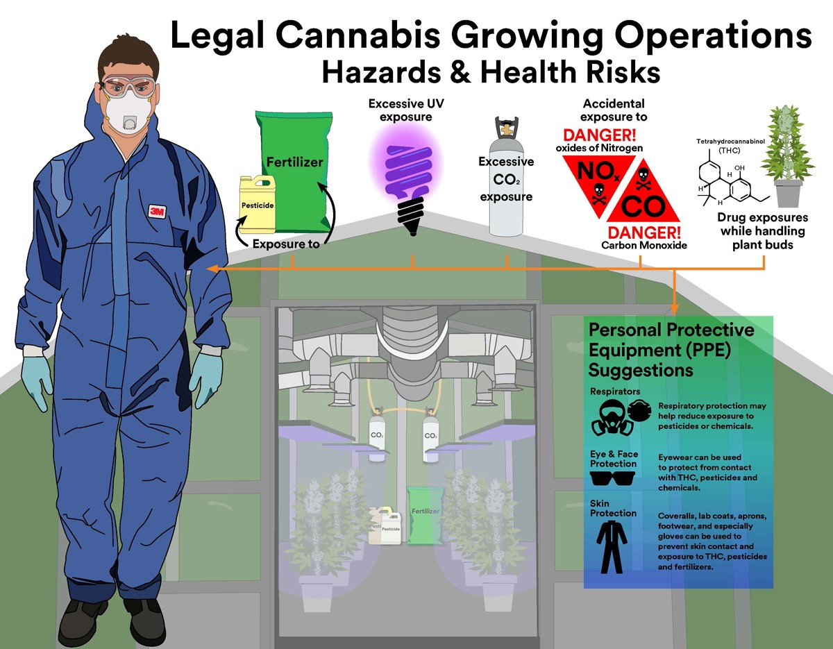
Whose Regulating Cannabis? OSHA/NIOSH/The States?
Fed OSHA: General Duty Clause- Section 5 (a)(1) – Provide a safe work environment, broad standards
NIOSH: Recommends Healthy Work Conditions, No Enforcement
State OSHA Plans: Aggressive? Standards? Regulations? Guidelines?

Slide 21
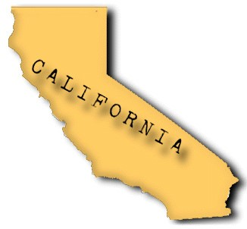
Certain States Inhale Deeply
As California Goes, So Does the Nation
Cal OSHA Cannibus Mandate:
“ Employers who cultivate, manufacture, distribute, sell, and test marijuana products, must take steps to protect their employees from all health and safety hazards associated with their work per Cal OSHA standards.”

Slide 22
Cal OSHA Has Regulations Applicable to All Aspects of the Industry:
Electrical Hazards
Exposures to Airborne Contaminants
Flammable Liquids and Gases
Hazard Communication
Hazardous Energy – Lockout/Tagout
Heat Illness Prevention
Injury and Illness Prevention Program
Machine Hazards
Personal Protective Equipment
Point of Operation Hazards
Pressure Vessels
Prohibition of Smoking in the Workplace
Repetitive Motion Injuries
Sanitation and Pest Control
Slips, Trips, Falls and Use of Ladder

Slide 23
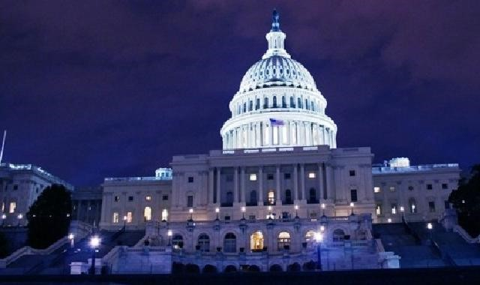
Most States Apply Federal OSHA Standards or “Guidelines”
Colorado: Fed OSHA controls/ “Guide to Worker Safety and Health in the Marijuana Industry”
Vermont: Federal OSHA standards, some general state exposure limits
Massachusetts: Cannabis Control Commission…guidance, recommendations
Maine: Registered dispensary may be subject to inspection by the local fire department, building inspector or code enforcement officer

Slide 24
Temporary Workers Ideal for Cannabis Industry
Adaptable to Seasonal Changes
Reduction in Benefits
ALSO: ON OSHA’s RADAR

Slide 25
2013 FED OSHA Temporary Worker Initiative
"………temporary workers" are workers hired and paid by a staffing agency and supplied to a host employer to perform work on a temporary basis. “
OSHA considers staffing agency and host employer to be "joint employers"
“Staffing agencies have a duty to inquire into the conditions of their workers' assigned workplaces”
“Staffing agencies need not become experts on specific workplace hazards, but they should determine what conditions exist at their client (host) agencies, what hazards may be encountered, and how best to ensure protection for the temporary workers.”
“…inquire and verify….”

Slide 26
California Only State (So Far) to Tie Licensing to OSHA Regulations
The Control, Regulate and Tax Adult Use of Marijuana Act of 2016 (AUMA) requires all cannabis license applicants to complete a Cal OSHA 30 hour safety class
Something for staffing agency to confirm during initial client contact?

Slide 27
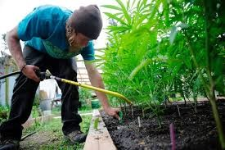
Known Cultivator/Agricultural Hazards
Respiratory, eye and dermal exposures to 8-9-tetrahydrocannabinol (THC) while handling plant buds
Pesticides/fertilizers exposure
Excessive ultraviolet (UV) exposure from grow lamps
Disproportionate carbon dioxide (CO2) exposure in greenhouses
Accidental carbon monoxide (CO) and oxides of nitrogen (NOx) exposure
Burns/shock from improper wiring of grow lamps and other equipment, including butane extraction
Cuts, nicks, scrapes from harvesting the buds, flowers and other elements of the plant
Pinches, carpal tunnel and repetitive stress during harvesting
Mold exposure/improper ventilation
Heat-stress from working in outdoor facilities, especially greenhouses

Slide 28
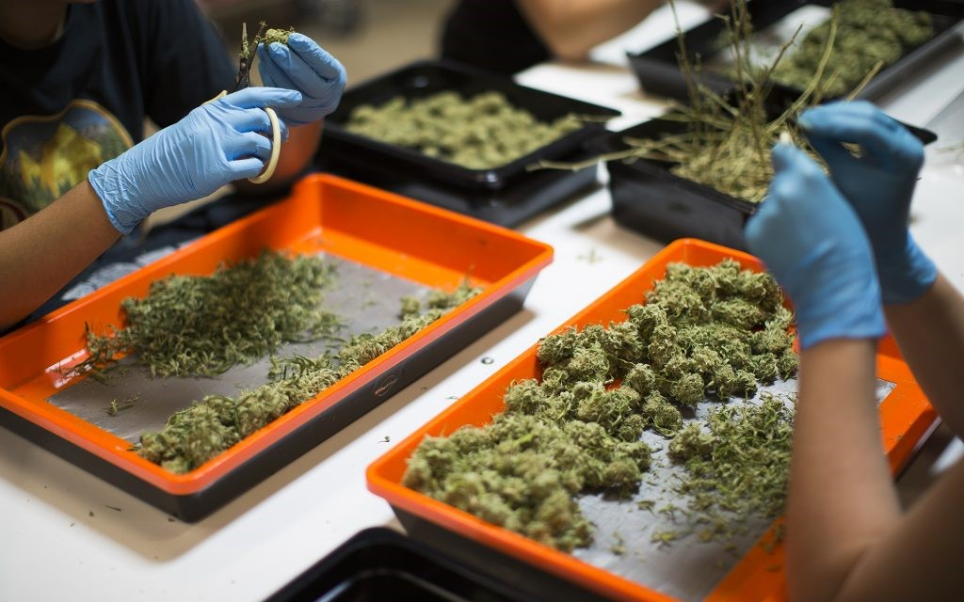
Known Processor/Handler Hazards:
Mechanical/Chemical injuries during extraction
Edible cooking injuries
Cuts/amputations from knives and slicers;
Burns
Electrical Risks
Exposure to Cleaners/Sanitizers
Slips, Trips and Falls

Slide 29
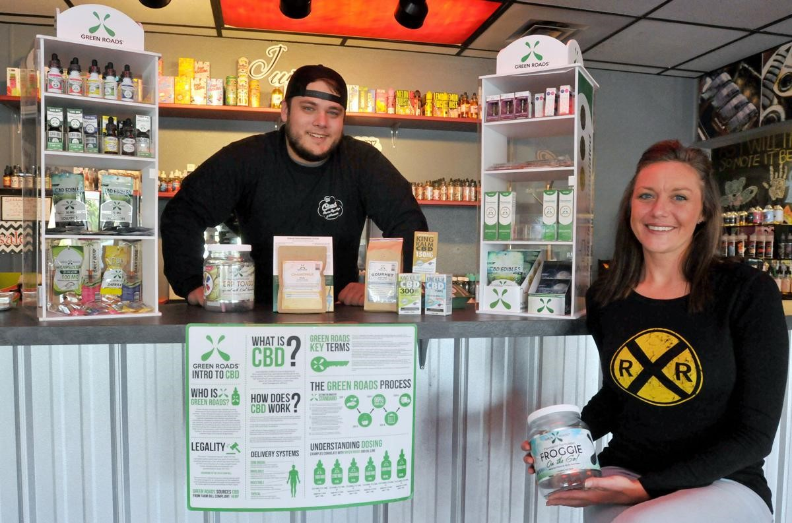
Retailers – Store Setting
Ergonomics - Sprains and strains due to lifting and stocking products
Workplace violence, robberies – No specific OSHA standards for workplace violence
Slips, trips and falls

Slide 30
Getting Serious: Cal/OSHA Cites Cannabis Manufacturer After Explosion
2018 worker burned using propane to extract oil from cannabis leaves indoors
Employer failed to test the atmosphere for flammable gases or vapors
10 Violations
No emergency action plan
No hazard communication program
$50,470 Fines
HIGHLY PUBLICIZED FOR MAXIMUM IMPACT

Slide 31
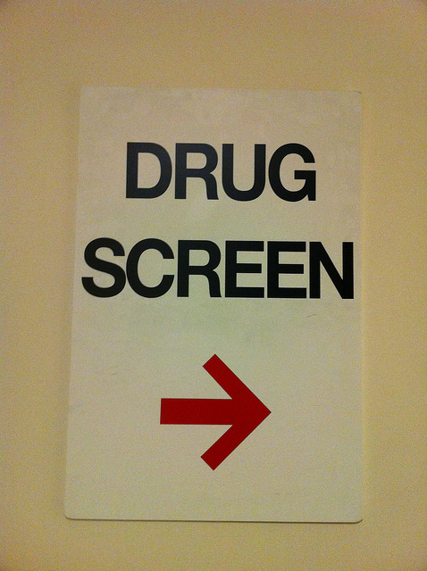
Employers Ask…..
Do OSHA’s Whistleblower Protections Under 29 C.F.R. 1904.35 Prohibit Drug Testing? No, if…..
Section 1904.35(b)(1)(iv) – permissible to test employees who report work-related injuries or illnesses if objectively reasonable basis for testing
permissible to drug test under a state workers’ compensation law

Slide 32
Employers Ask…..
What Drug Testing Practices Pass the OSHA Sniff Test?
Reasonableness Standard:
Drug use suspected as cause
Other involved employees tested
Drug test effective to assess “impairment”
Testing for root cause analysis, not discipline
Drug use and injury compatible (repetitive strain)
ADA LAWS CONTROL PRE-EMPLOYMENT DRUG TESTS

Slide 33
Employers Ask?
Who Must Provide Haz Comm Training? Client or Staffing Agency?
OSHA: Shared responsibility
Staffing Agency: Must train about hazardous chemicals in the work area, cover categories of flammability, carcinogenicity 29 CFR 1910.1200 (h)(1)
Client: Specify qualifications for employees, train on specific chemicals or personal protective equipment (PPE) and the Safety Data Sheet guidelines

Slide 34
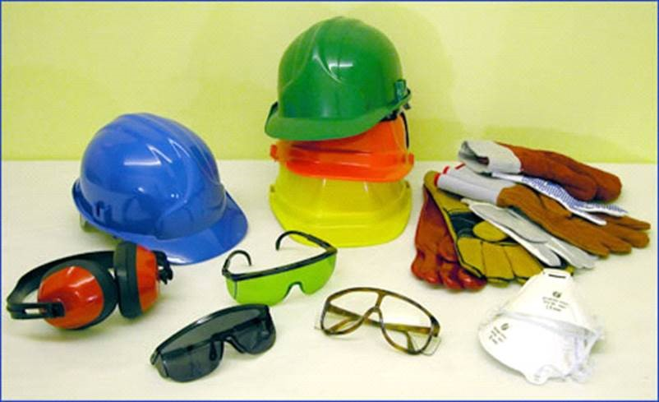
Employers Ask?
Who Must “Furnish” Personal Protective Equipment? Client? Staffing Agency?
FED OSHA: joint obligation to provide PPE at no cost 29 CFR 1910
CAL OSHA: no Title 8 standard requires employer to pay; Bendix Forest Products Corp v. OSHA (1979) 25 Cal.3rd 465; rule not yet final
Exceptions: Employee has PPE/steel-toe shoes or steel-toe boots/RX safety eyewear/everyday clothing, such as long-sleeve shirts, long pants, street shoes, and normal work boots or ordinary weather protection

Slide 35
OSHA’s Enforcement Focus on Staffing Agencies
Staffing agency's actual or constructive knowledge of the worksite's hazards (exercise of reasonable diligence)]
Staffing contract terms – Defined responsibilities for training/PPE
Level of staffing agency contact with temporary workers
System to address complaints or concerns

Slide 36
How Staffing Agencies Can Avoid OSHA Violations
Establish Clear Job Descriptions/Limitations
Identify Key Hazards and Protections
Review and update a checklist to address foreseeable safety and health concerns at client workplaces.
Use checklist for initial and periodic safety and health inspections
Require Sign Offs by workers on their Site Specific Training

Slide 37
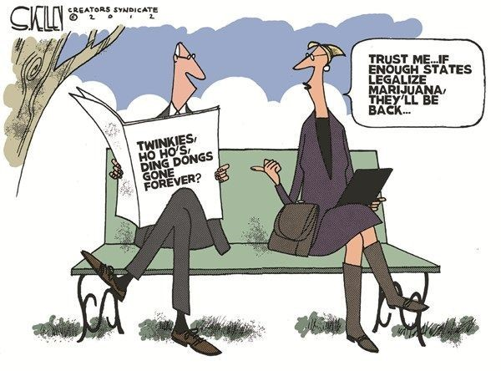
Questions?

Slide 38
Two Issues
• Impact on Marijuana on the workplace
• Growth of placements in the Cannabis Industry
They are intertwined-the more the drug becomes legal…the more people will use it…the more you will find it in your workplace…

Slide 39
More than a quarter of Americans now live in areas that allow some form of legal cannabis for either medical or recreational use. Legal marijuana is becoming big business.
Retail sales 2016 more than $6.5 billion. 2017 almost 10 million 2018 13.5 billion 2021- estimated to be near 17 billion 2025- estimated to be near 25 Billion
According to Marijuana Business Daily's newest report, "Marijuana Business Factbook 2017

Slide 40
Issue One
• Marijuana In the workplace
• According to ZipRecruiter.com co-founder and CEO, Ian Siegel, Marijuana in fastest-growing job category in the United States”
• “445% job growth in job listings in the category year over year

Slide 41
• More American workers are testing positive for drugs than they have in the past 12 years, according to a recent study conducted by Quest Diagnostic.^{[i]} • Overall, marijuana positivity continued its five-year upward trajectory • Marijuana positivity increased four percent in the general U.S. workforce and nearly eight percent in the safety-sensitive workforce • Increases in marijuana positivity in the general U.S. workforce were most striking in states that have enacted recreational use statues since 2016. Nevada (43%), Massachusetts (14%), California (11%) These three states also saw significant increases in marijuana positivity in federally-mandated, safety-sensitive workers: Nevada (39%), California (20%), and Massachusetts (11%). Federally-mandated, safety-sensitive workers include pilots, rail, bus and truck drivers, and workers in nuclear power plants, for whom routine drug testing is required by the DOT.

Slide 42
In the past 12 years--primary drugs being identified in the drug screens are marijuana, cocaine, and methamphetamine
• 61% of drug failures were for Marijuana
• Marijuana positive tests increased 75% from 2013 to 2016. (Urine and hair testing)

Slide 43
With staffing firms already struggling to find capable employees to place, the need for bodies is even more dramatic. Drug screen failures have increased by 10-15% in states where Marijuana is legal. Many staffing firms are choosing to take Marijuana off the drug screens, because they cannot fill all the job requests since the are so many fails.
Unfortunately, this leads many firms to hire ”a warm body”. Therefore, the quality of hire is called into question. That desperation leads to poor judgment and safety issues resulting in higher amounts of claims.

Slide 44
Zero Tolerance
Recreational use can still result in disqualification of a candidate. Authorized medical use, however, calls into play disability statutes and the issue of reasonable accommodations. You must be careful here with regard to placement and hiring.
Most companies not subject to statutory zero tolerance policies are free to adopt such policies and, in fact, many industry sectors do adopt zero tolerance policies driven mainly by workplace safety concerns.

Slide 45
It is illegal in all states (each state has different levels of impairment) to drive under the influence therefore 5-10 nano grams depending on blood or saliva testing could mean DUI.
Yet people will allow workers to perform hazardous job functions with the same levels in their system or roll the dice with no testing at all.

Slide 46
What are staffing companies to do?
The best practice is to develop a drug policy to address the issue that must:
1. Create awareness 2. Educate both candidates and employees about the legal landscape and the applicable drug screening policies and procedures.
3. List acceptable activities, screening procedures and enforcement provisions
Finally, the policy should be communicated regularly to candidates, employees and, yes, to clients as well.

Slide 47
Issue Two
Placements to Marijuana Growers/Distributors Industry
Different states - different laws. Staffing firms and brokers must be aware of individual state and federal restrictions
WC excluding coverage for claims arising from these industries
Exclusions – existing or to come – potential coverage gap

Slide 48
We have had many questions and there is little info provided to evaluate.
With any new service or industry we encounter for our staffing program – we analyze as much data available to identify areas of concern to develop overview, guidelines, etc. Unfortunately, there is not a lot of reliable statistical data.
As you can see by the prior slides, you have many conflicting opinions and case law presented support for both sides of the issue.

Slide 49
Potential Exposures
Potential Exposures are just starting to be identified for the client. They include…
Lack of focus Absenteeism
Distraction Not caring about job or circumstances
Driving accidents Lack of empathy
Poor productivity Perception (side to side and depth)

Slide 50
Therefore the PL, GL, EPLI, Product Liability, Property, Crime and WC are an issue.

Slide 51
Only handful of carriers are writing the client companies
Most major carriers…are taking wait & see attitude 1. Federal vs. state issues, Federal class 1 illegal drug, banking issues, data support. 2. The majority of those writing are offering limited coverage some limits as low as $250,00-$500,000 well below what is needed…regardless of size of grower, etc. 3. Some are giving higher limits but reduced coverage. Many cannabis companies are choosing not to obtain the proper coverage – especially the smaller companies.
Currently, handful of carriers writing insurance for Growers/Distributors.
1. Cannasure, Admiral, Golden Bear. 2. E&S carriers reluctant to write US exposure due to law. 3. Will entertain Canadian risks on individual basis 4. WC-some PEO’s

Slide 52
What does this mean for Staffing Firms?
There are many new ventures -staffing firms are creating separate companies to house the exposures of this industry.
• Limited if any staffing experience in this industry.
• No info on client companies and their protocols – or insurance they have.
• Identify the staffing workers as admin (sales i.e. budtender).
• Most brokers are not prepared to provide answers or proper class codes.

Slide 53
New Regulation
With new regulation, will employee positions in demand develop into a new “professional” class? i.e. Budtenders, trimmers, growers.
• Licensing and education requirements – Budtenders example. Most experience required is personal knowledge of the product.
• Edibles – a lot of background is needed here. 1. Recalls. 2. Improper labeling

Slide 54
Contracts
Inadequate client company insurance results in major liability for the Staffing Firm.
• All client operations have coverage issues therefore signing a lopsided contract or not checking the your client coverage and limits….could leave you assuming much of the risk.
• Be the expert yourself, employ a strong drug policy.
• Have your attorney review your contacts, employee handbook etc.

Slide 55
Conclusion
This is happening, the world is changing. If you are going after this potentially 25 billion market. You cant be expected to know it all..
Use your attorney, your insurance carrier, your broker and build a program that protects you and your company.

Slide 56
Bob Thompson rthompson@wwspi.com 631-390-0900 x416 wwspi.com

